Slide 1
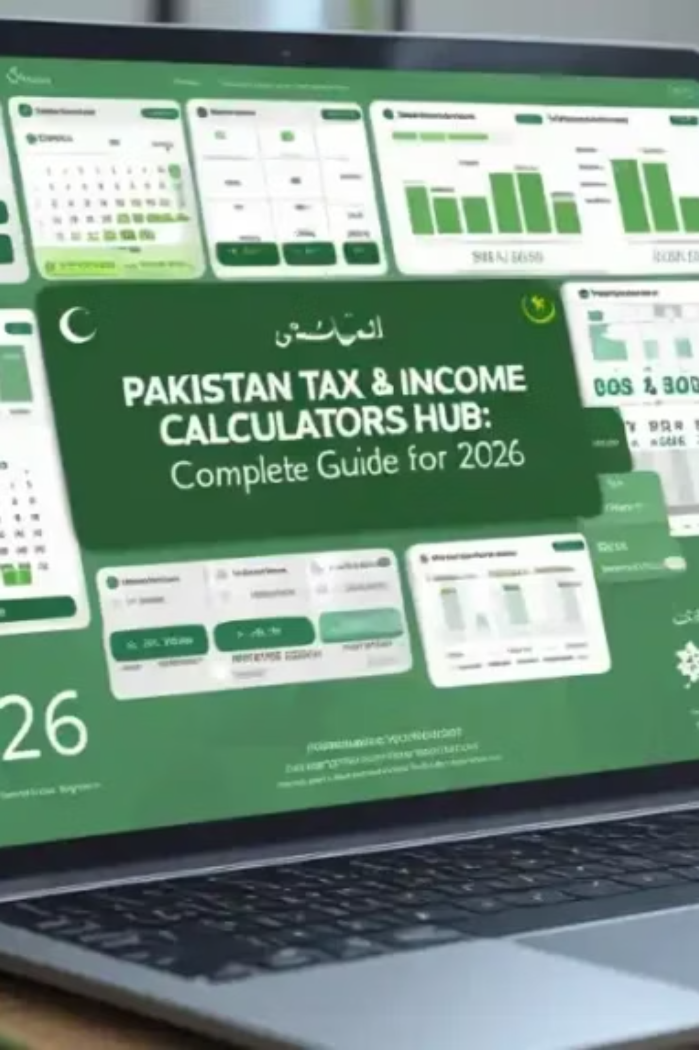
Pakistan Income Tax Calculator: Complete Guide 2024–25
Whether you earn PKR 50,000 or PKR 500,000 monthly, understanding your tax liability helps you plan finances better. The Federal Board of Revenue (FBR) sets tax slabs annually — this guide walks you through everything: salary brackets, gross vs. net salary, tax regimes, and practical examples for salaried employees, freelancers, and business owners.
TOOLIFY WORLDS
FBR 2024–25

Slide 2

What is Income Tax in Pakistan?
Income tax is a mandatory contribution individuals and businesses pay based on annual earnings. Pakistan's tax year runs July to June, managed by the FBR through the IRIS portal. The system divides taxpayers into three categories: salaried persons, self-employed/freelancers, and businesses — each using a progressive slab system where higher income means higher rates.
Taxable income isn't simply your salary — it's what remains after eligible deductions like provident fund contributions, medical allowances, and house rent allowance. The Income Tax Ordinance 2001 provides the legal framework, updated annually by Finance Act amendments.

Slide 3

Why Tax Calculation Matters
Avoid Penalties
Filer vs. Non-Filer
Legal Tax Savings
Underpaying leads to penalties and interest charges during filing season. Accurate monthly estimates prevent surprises.
Active Taxpayers List (ATL) filers enjoy lower withholding rates on bank withdrawals, property purchases, and vehicle registration — sometimes half the non-filer rate.
Charitable donations, government securities, and pension fund contributions all reduce taxable income — but only if you calculate correctly.
Learn more at the Pakistan Tax Income Calculator Guide.

Slide 4
Pakistan Income Tax Slabs 2024–25
The progressive slab system taxes different portions of income at different rates for salaried individuals:
Annual Income (PKR)
Tax Rate
Tax on Excess
Up to 600,000
0%
Nil
600,001 – 1,200,000
5%
On amount over 600,000
1,200,001 – 2,400,000
15%
On amount over 1,200,000
2,400,001 – 3,600,000
25%
On amount over 2,400,000
3,600,001 – 6,000,000
30%
On amount over 3,600,000
Above 6,000,000
35%
On amount over 6,000,000
For the full 2026 tax guide, visit the Pakistan Income Tax Guide 2026.

Slide 5
Salary Tax Examples: Different Income Levels
PKR 50,000/month
PKR 75,000/month
Annual: PKR 600,000 — exactly at exemption threshold. Tax: Zero. Net salary equals gross salary. EOBI/social security may still apply.
Annual: PKR 900,000. Taxable: PKR 300,000 @ 5% = PKR 15,000/year. Monthly tax: ~PKR 1,250. Net: PKR 73,750.
PKR 100,000/month
PKR 150,000/month
Annual: PKR 1,200,000. PKR 600,000 @ 5% = PKR 30,000/year. Monthly tax: PKR 2,500. Net: ~PKR 97,500.
Annual: PKR 1,800,000. PKR 30,000 (5%) + PKR 90,000 (15%) = PKR 120,000/year. Monthly tax: PKR 10,000. Net: ~PKR 140,000.
PKR 200,000/month
PKR 500,000/month
Annual: PKR 2,400,000. PKR 30,000 + PKR 180,000 = PKR 210,000/year. Monthly tax: PKR 17,500. Net: ~PKR 182,500.
Annual: PKR 6,000,000. Total tax across all slabs: PKR 1,230,000/year. Monthly tax: ~PKR 102,500. Net: ~PKR 397,500.

Slide 6

Freelance Income Tax in Pakistan
Freelancers earning from international clients via Upwork, Fiverr, or direct contracts must register for an NTN once annual income exceeds PKR 600,000. Tax is calculated under normal slabs, but business expenses — internet, software, equipment depreciation, workspace rent — are deductible.
Normal Tax Regime
Presumptive Tax Regime
Income taxed under standard progressive slabs. Claim all legitimate business expenses to reduce taxable income.
FBR taxes a fixed percentage of gross receipts — simpler but may not suit high-expense businesses. Freelancers above PKR 1M annually should compare both options.
Export-oriented freelancers receive additional benefits and reduced rates. See the Pakistan Income Tax Guide 2026 for current regulations.

Slide 7

Business Profit Tax in Pakistan
Corporate Tax Rates
Presumptive Tax Regime
Banking companies: 29%. Small companies (below turnover threshold): 35%. Standard rates apply to others under the Companies Act.
Retailers, wholesalers, and service providers can pay tax as a percentage of annual turnover — eliminating complex accounting while ensuring compliance.
Advance Tax & Credits
Quarterly advance tax installments are mandatory. Tax credits for plant/machinery investment and export-unit exemptions can substantially reduce effective rates.
Explore more financial tools at Online Revenue Calculators.

Slide 8

How to Calculate Your Net Salary After Tax
Subtract Exemptions
Gross Monthly Salary
Apply Tax Slabs
Compute Monthly Net
Additional statutory deductions — provident fund, EOBI contributions, and professional tax — further reduce take-home pay. Online calculators automate this process, but understanding the mechanics helps verify employer calculations and identify discrepancies.

Slide 9
FBR IRIS Portal: Your Tax Hub
The IRIS (Integrated Revenue Information System) portal is FBR's central platform for all taxpayer interactions. Through IRIS you can:
Filing Deadlines
Salaried individuals: September 30th
Calculate tax liability using built-in calculators
File annual returns electronically
Make advance tax payments
Track refund status and tax history
Business income earners: December 31st
Late filing penalty: PKR 1,000 + 0.1% of tax liability per day of delay
Registration requires your NTN, obtainable online or at FBR offices. The portal reflects current Finance Act rates with every update.
Missing deadlines also removes you from the Active Taxpayers List.

Slide 10

Filer vs. Non-Filer: The Financial Impact
Being on the Active Taxpayers List (ATL) creates significant cost differences in everyday transactions. See the full breakdown at Filer vs Non-Filer in Pakistan.
Bank Withdrawals (over PKR 50,000/day)
Property Purchases
Filer: 2% withholding tax
Non-Filer: 5% — 2.5× higher
Filer: 0.3% withholding tax
Non-Filer: 0.6% — double the rate
Financial Access
Banks increasingly require filer status for loans, credit cards, and investment opportunities as Pakistan moves toward a documented economy.

Slide 11
Tax Saving Tips for Pakistani Taxpayers
Provident & Pension Funds
Charitable Donations
Employee contributions to recognized provident funds and approved pension/annuity plans reduce taxable income while building retirement savings.
Donations to FBR-approved institutions qualify for 100% deduction. Always obtain receipts with the organization's tax exemption certificate number.
Government Securities & Investments
Business Expense Documentation
Investment in approved securities and profit/loss sharing accounts reduces taxable income up to prescribed limits — offering dual financial and tax benefits.
Travel, professional development, office supplies, and operational costs reduce taxable profit when properly recorded. Avoid mixing personal and business expenses.
For health and lifestyle financial planning tools, visit Health & Life Calculator Tools.

Slide 12
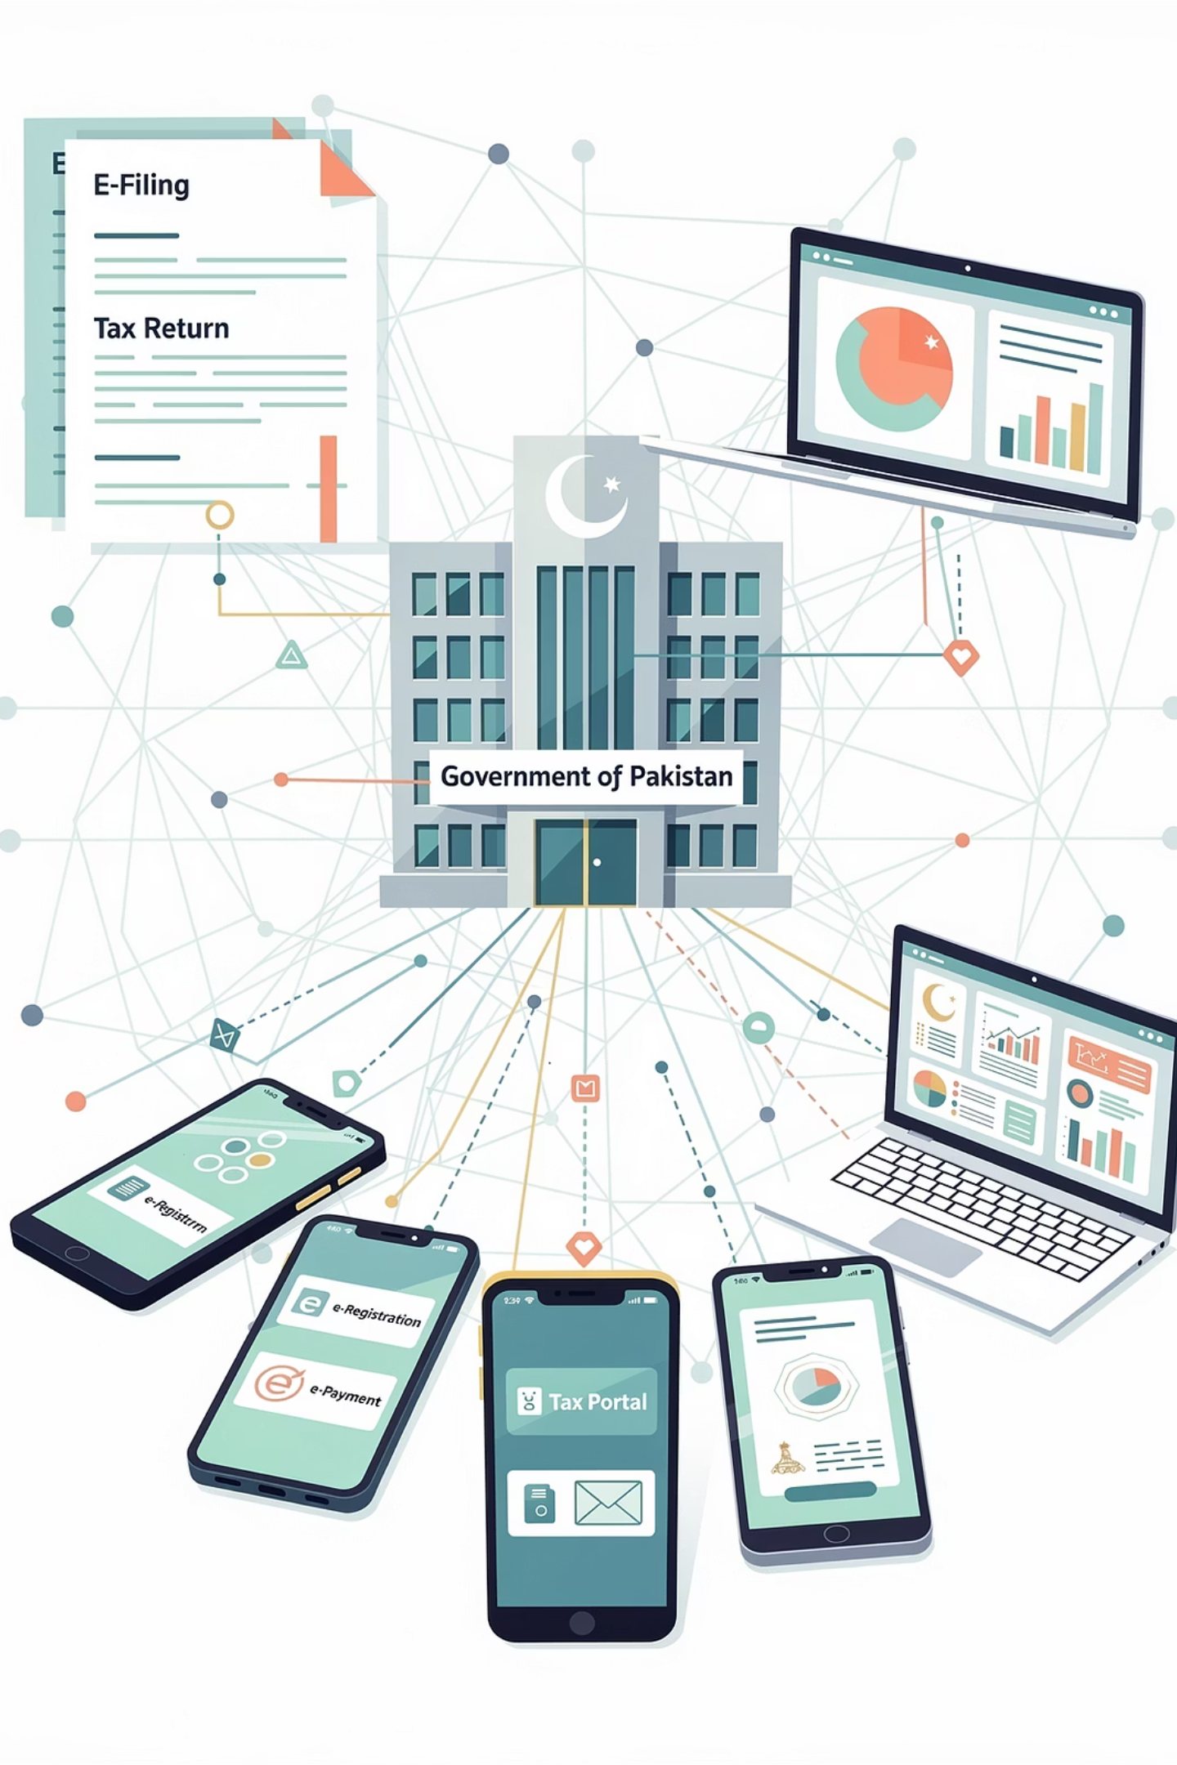
Super Tax & The Future of Pakistan Taxation
Super Tax 2026
Digital Transformation
High-income earners and large corporations face an additional super tax levy. Understanding eligibility and calculation is critical for tax planning. See the full guide: Super Tax Pakistan 2026: Who Pays It and How to Calculate.
FBR's IRIS automation reduces corruption and speeds processing. Integration with NADRA, banks, and utility companies enables real-time income verification. Pakistan's tax-to-GDP ratio expansion remains a priority — expect lower rates, fewer exemptions, and stricter enforcement ahead.

Slide 13
Frequently Asked Questions
Minimum taxable income 2024–25?
Do freelancers pay income tax?
PKR 600,000 annually. Below this, zero income tax applies — but you must still file returns if income exceeds this threshold.
Yes, if annual income exceeds PKR 600,000. Register for NTN, maintain records, file annual returns, and claim business expense deductions.
Gross salary vs. net salary?
When is the filing deadline?
Gross is total compensation before deductions. Net is your take-home after income tax, provident fund, EOBI, and other statutory deductions.
Salaried individuals: September 30th. Business income earners and companies: December 31st. Tax year runs July 1 – June 30.

Slide 14

Calculate Your Tax with Toolify Worlds
Toolify Worlds offers comprehensive tax calculators specifically designed for Pakistani taxpayers — accurate, up-to-date with FBR regulations, and requiring no login or registration.
Salary Tax Calculator
Freelance Tax Calculator
Instant results for all income levels with step-by-step breakdowns.
Tailored for self-employed professionals earning locally or internationally.
Business Profit Calculator
Corporate and SME tax computation with regime comparison tools.
Start calculating now: Pakistan Tax Income Calculator | Online Revenue Calculators

